Slide 1


Deep Learning
Class 5

Slide 2
GAN: Generative Adversarial Network
Two sub-models against each other
Adversarial Training
Generator
Discriminator

Slide 3
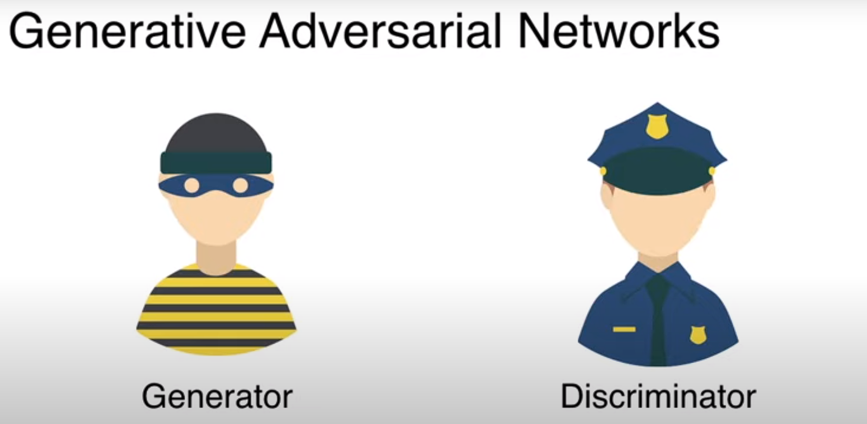

Slide 4
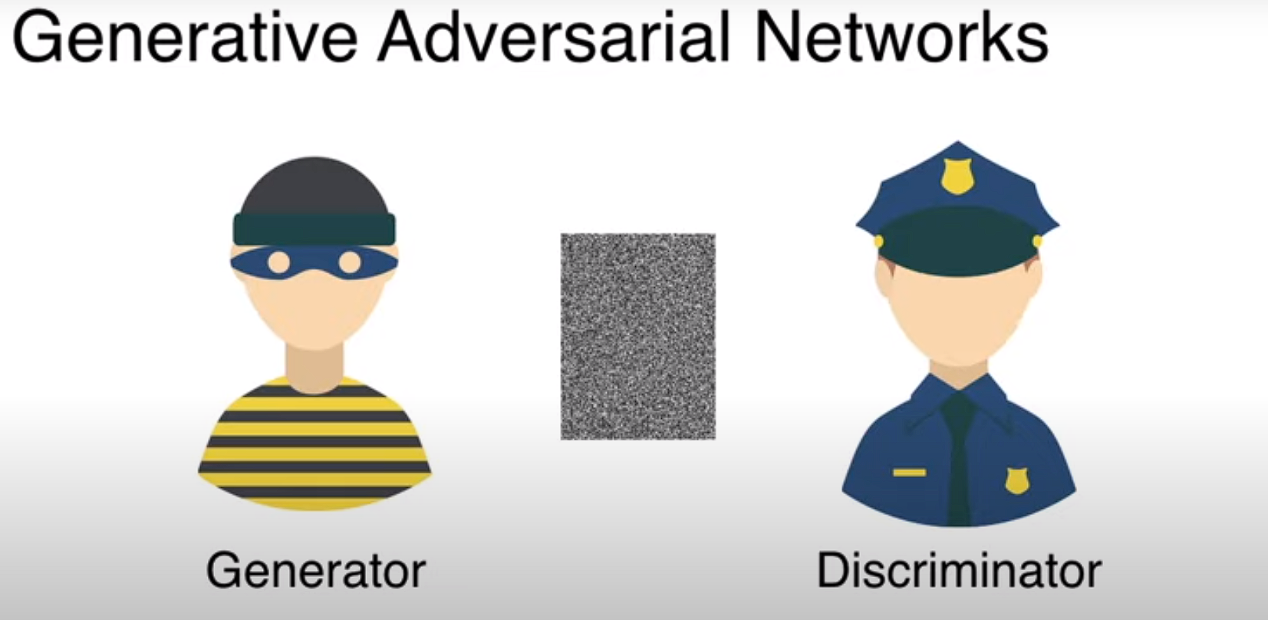

Slide 5
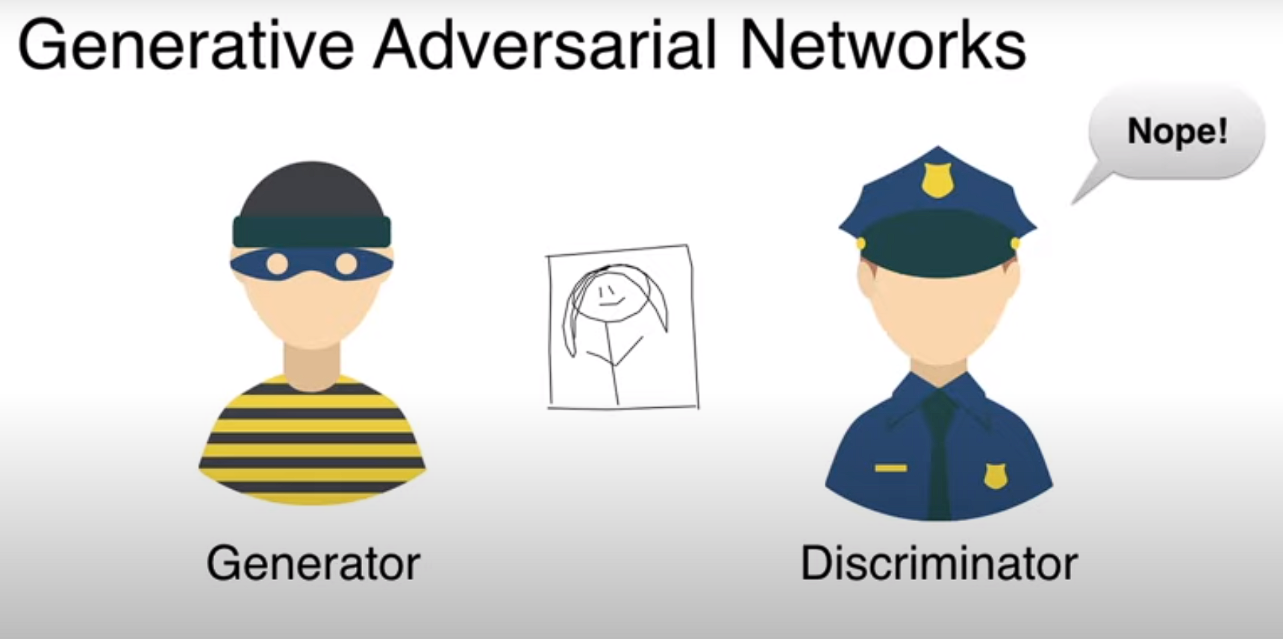

Slide 6
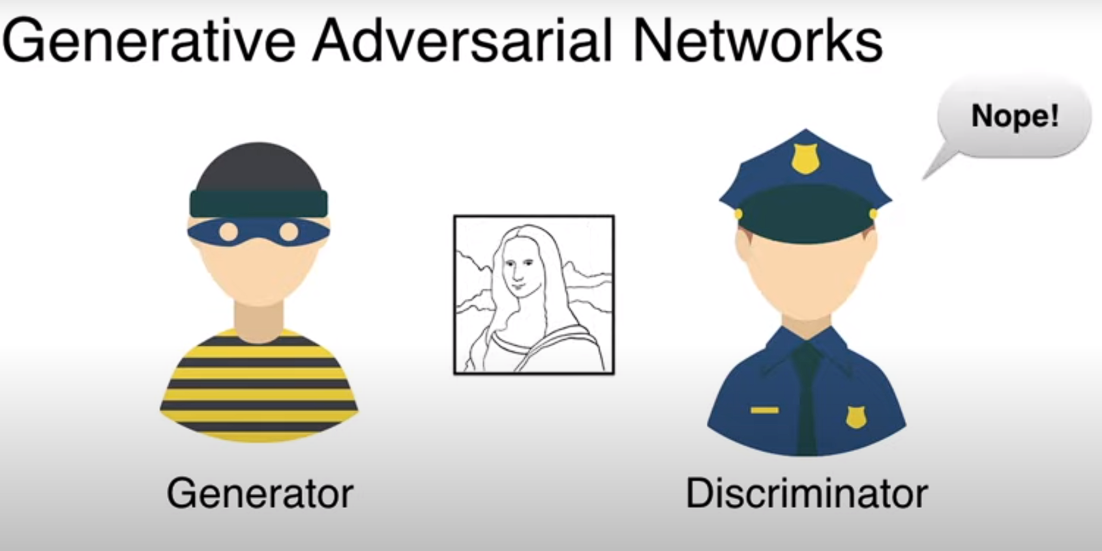

Slide 7
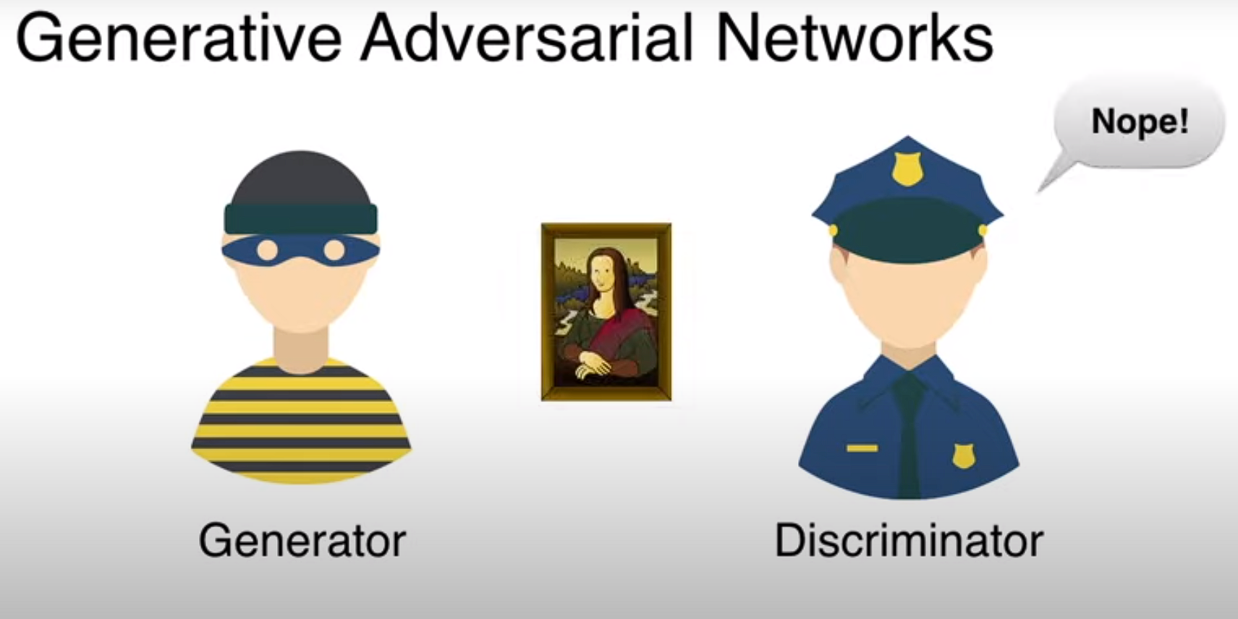

Slide 8
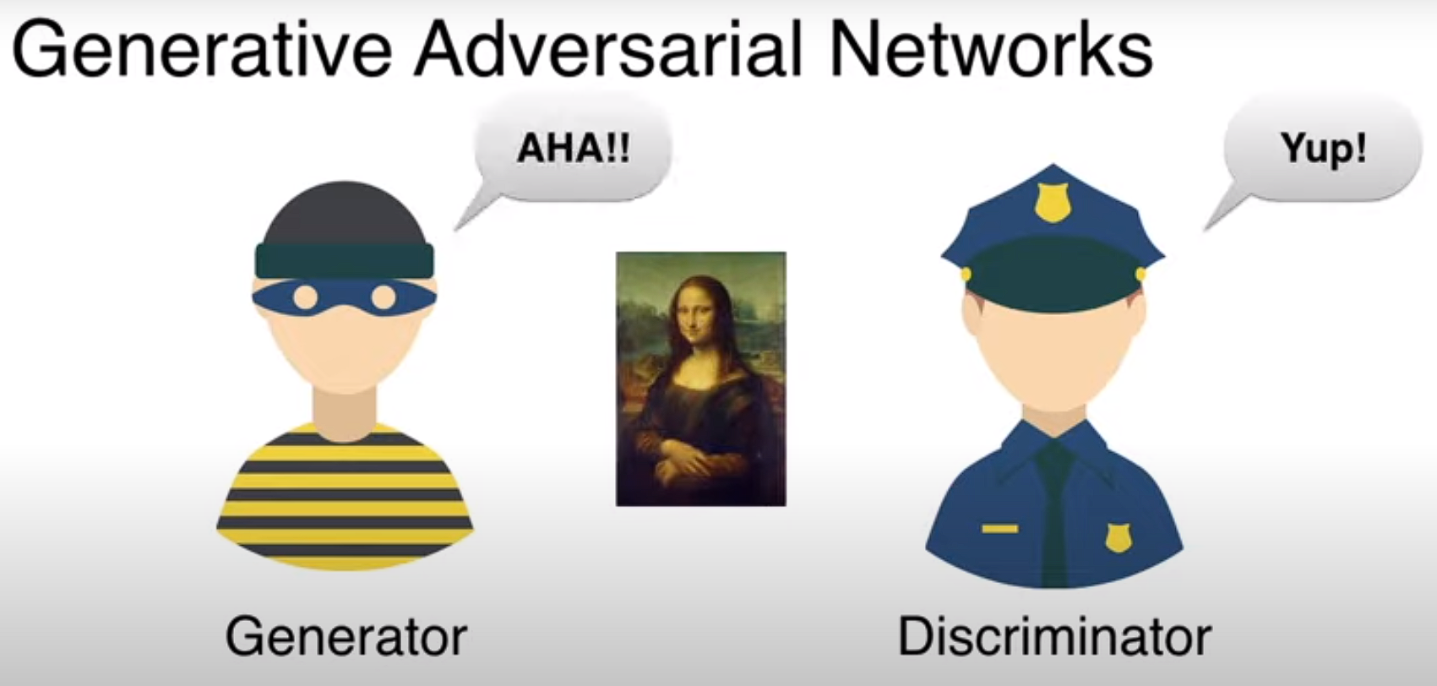

Slide 9
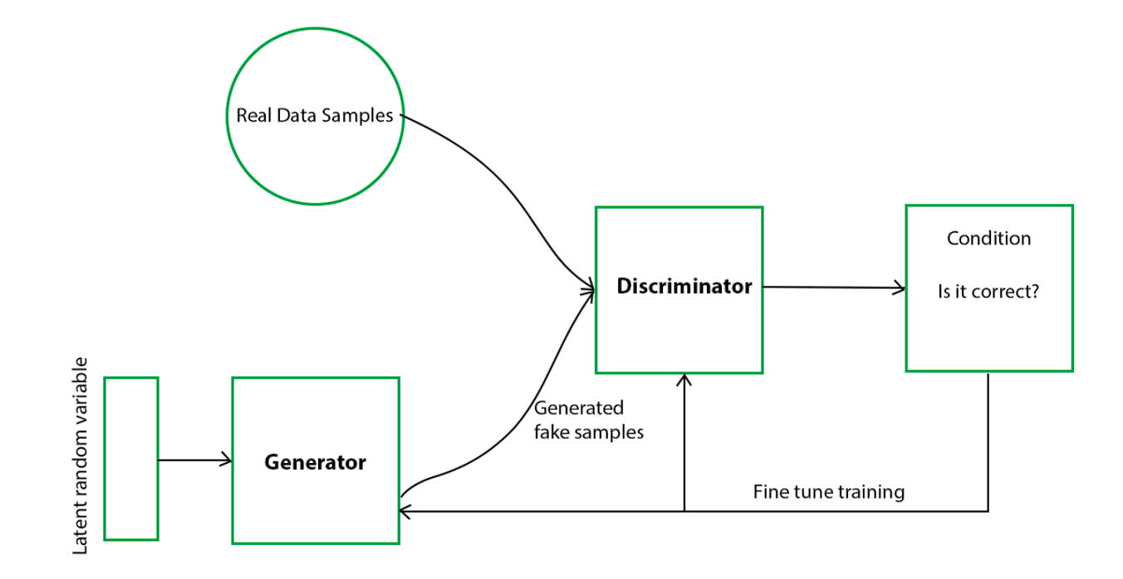

Slide 10


Slide 11
